Slide 1
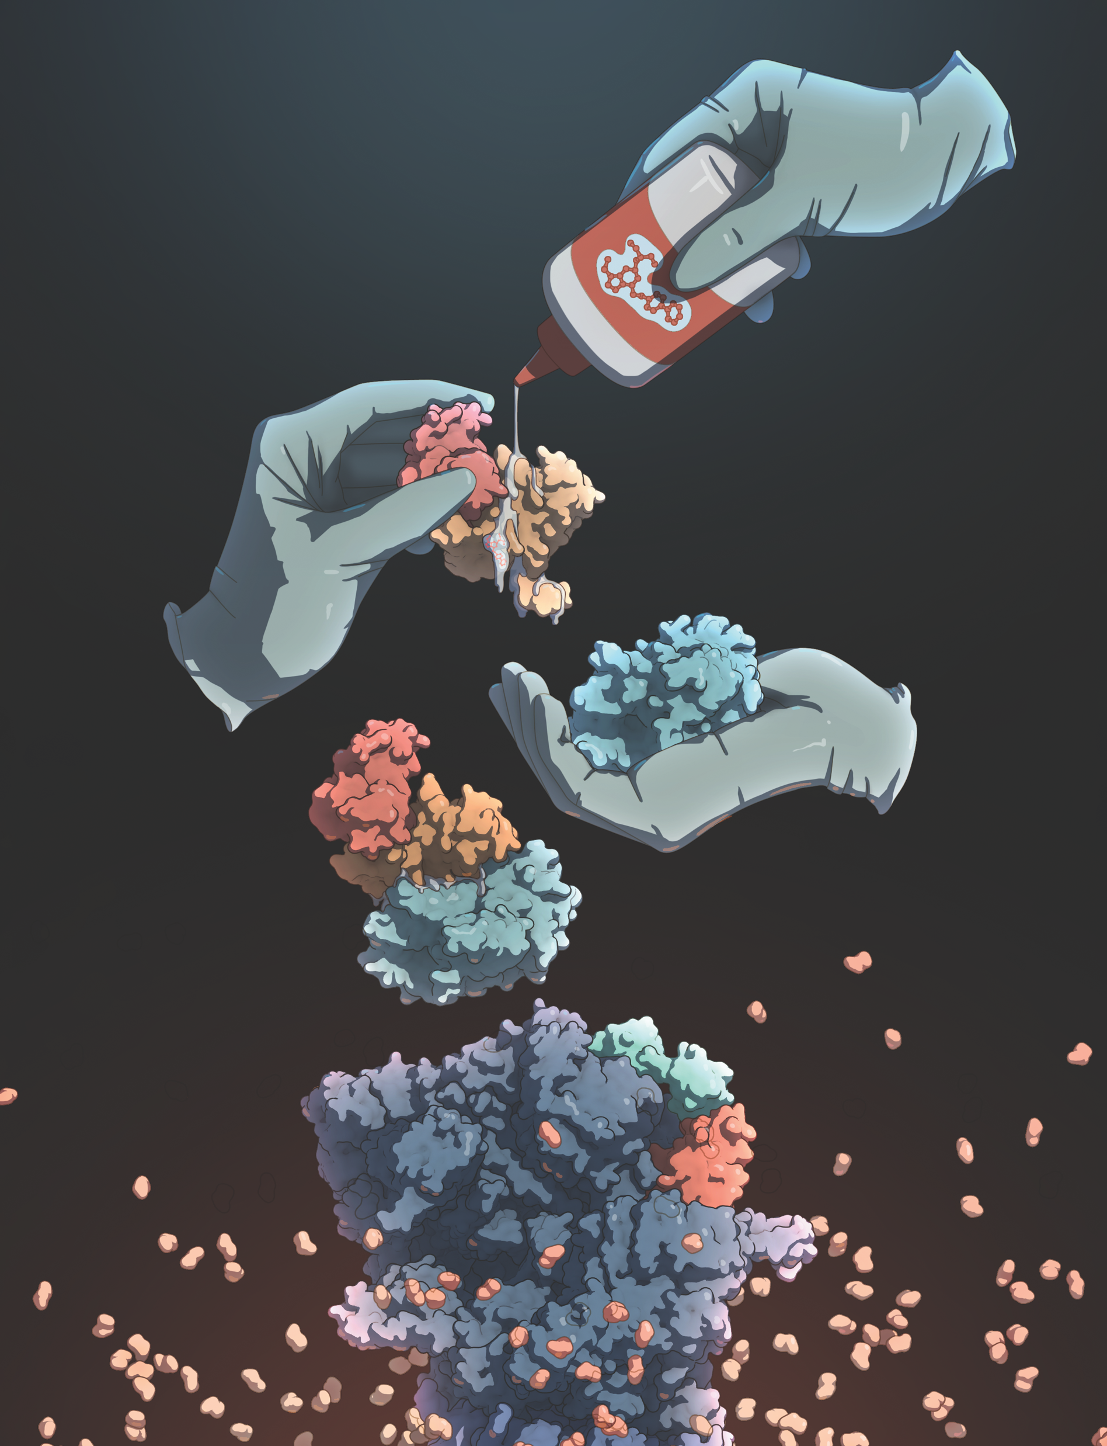
Proximity Mania!
Is there anything we cannot glue?!

Slide 2

Molecular Glues
Many more
Unicorns

Slide 3
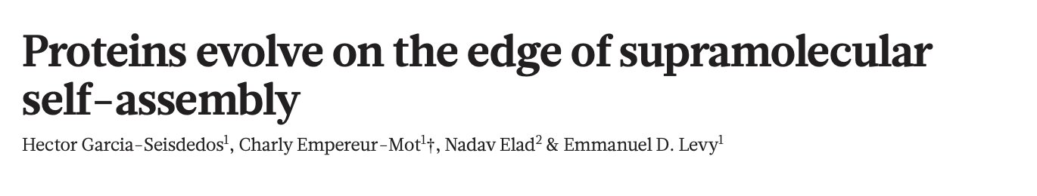
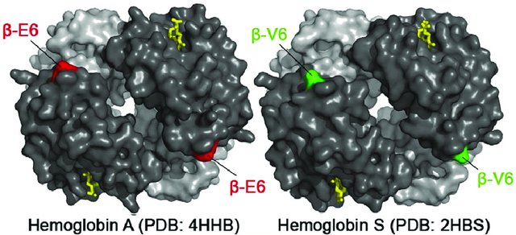
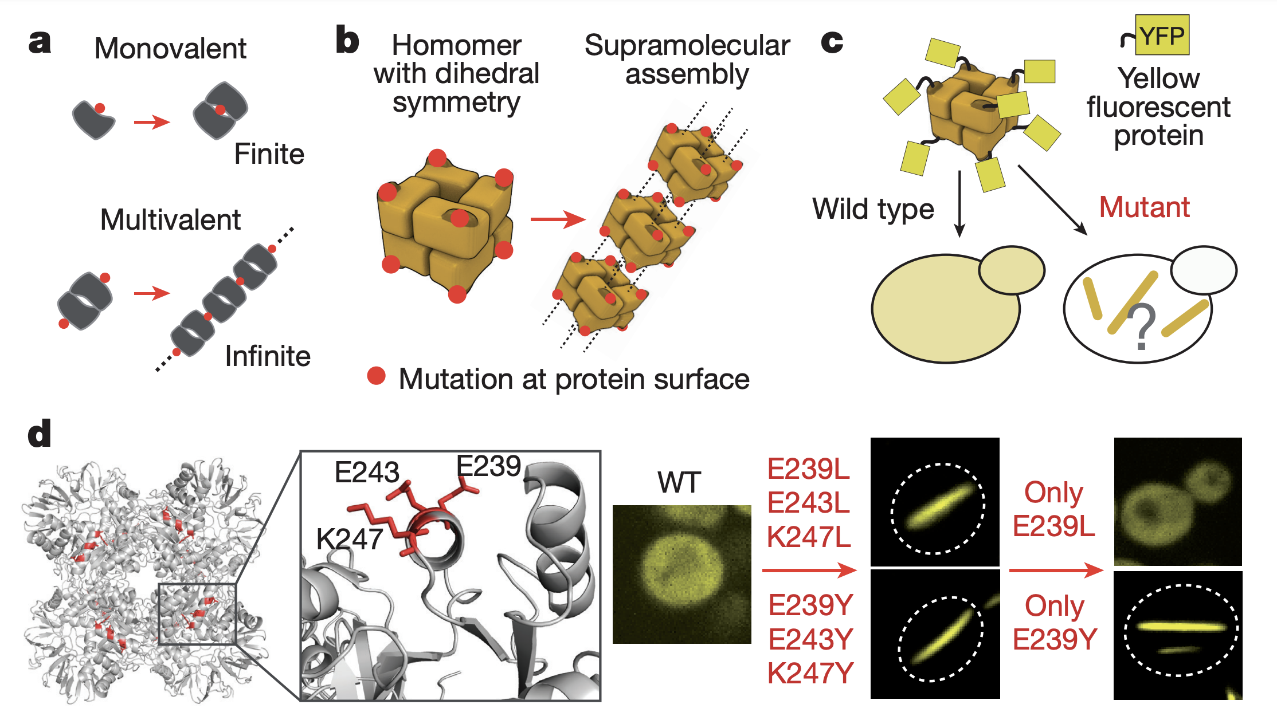
A single glutamate → valine change causes haemoglobin to form insoluble fibers
Adapted from Clark et al. (2012)

Slide 4
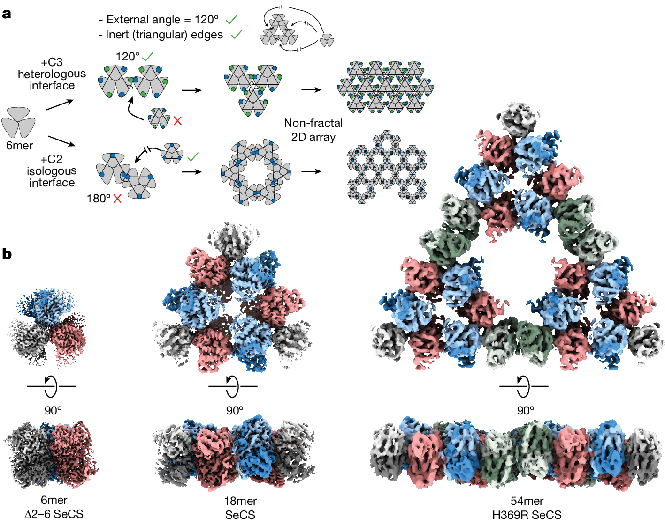
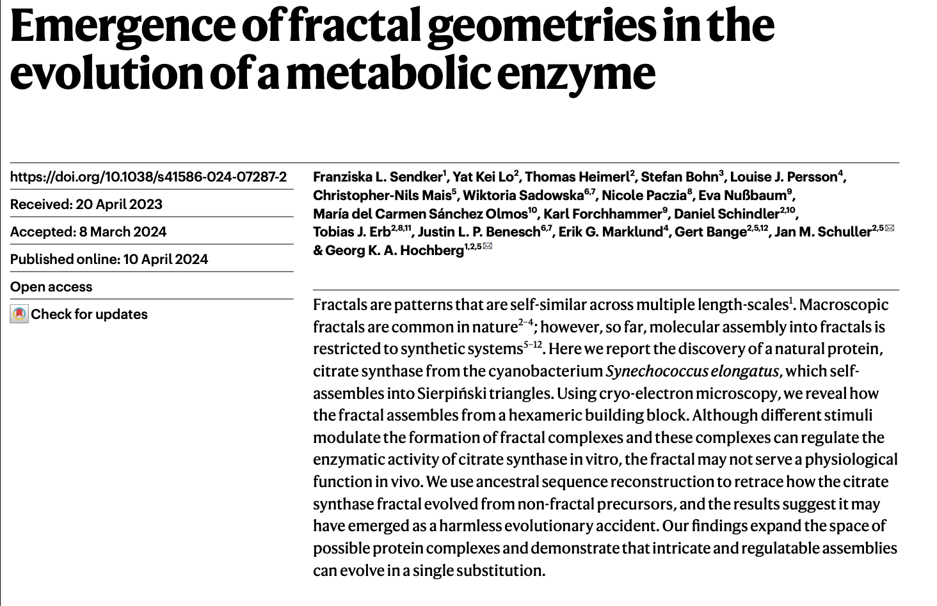
Courtesy of Guillaume Bélissent

Slide 5
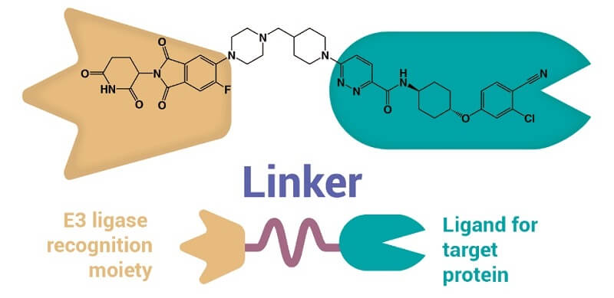
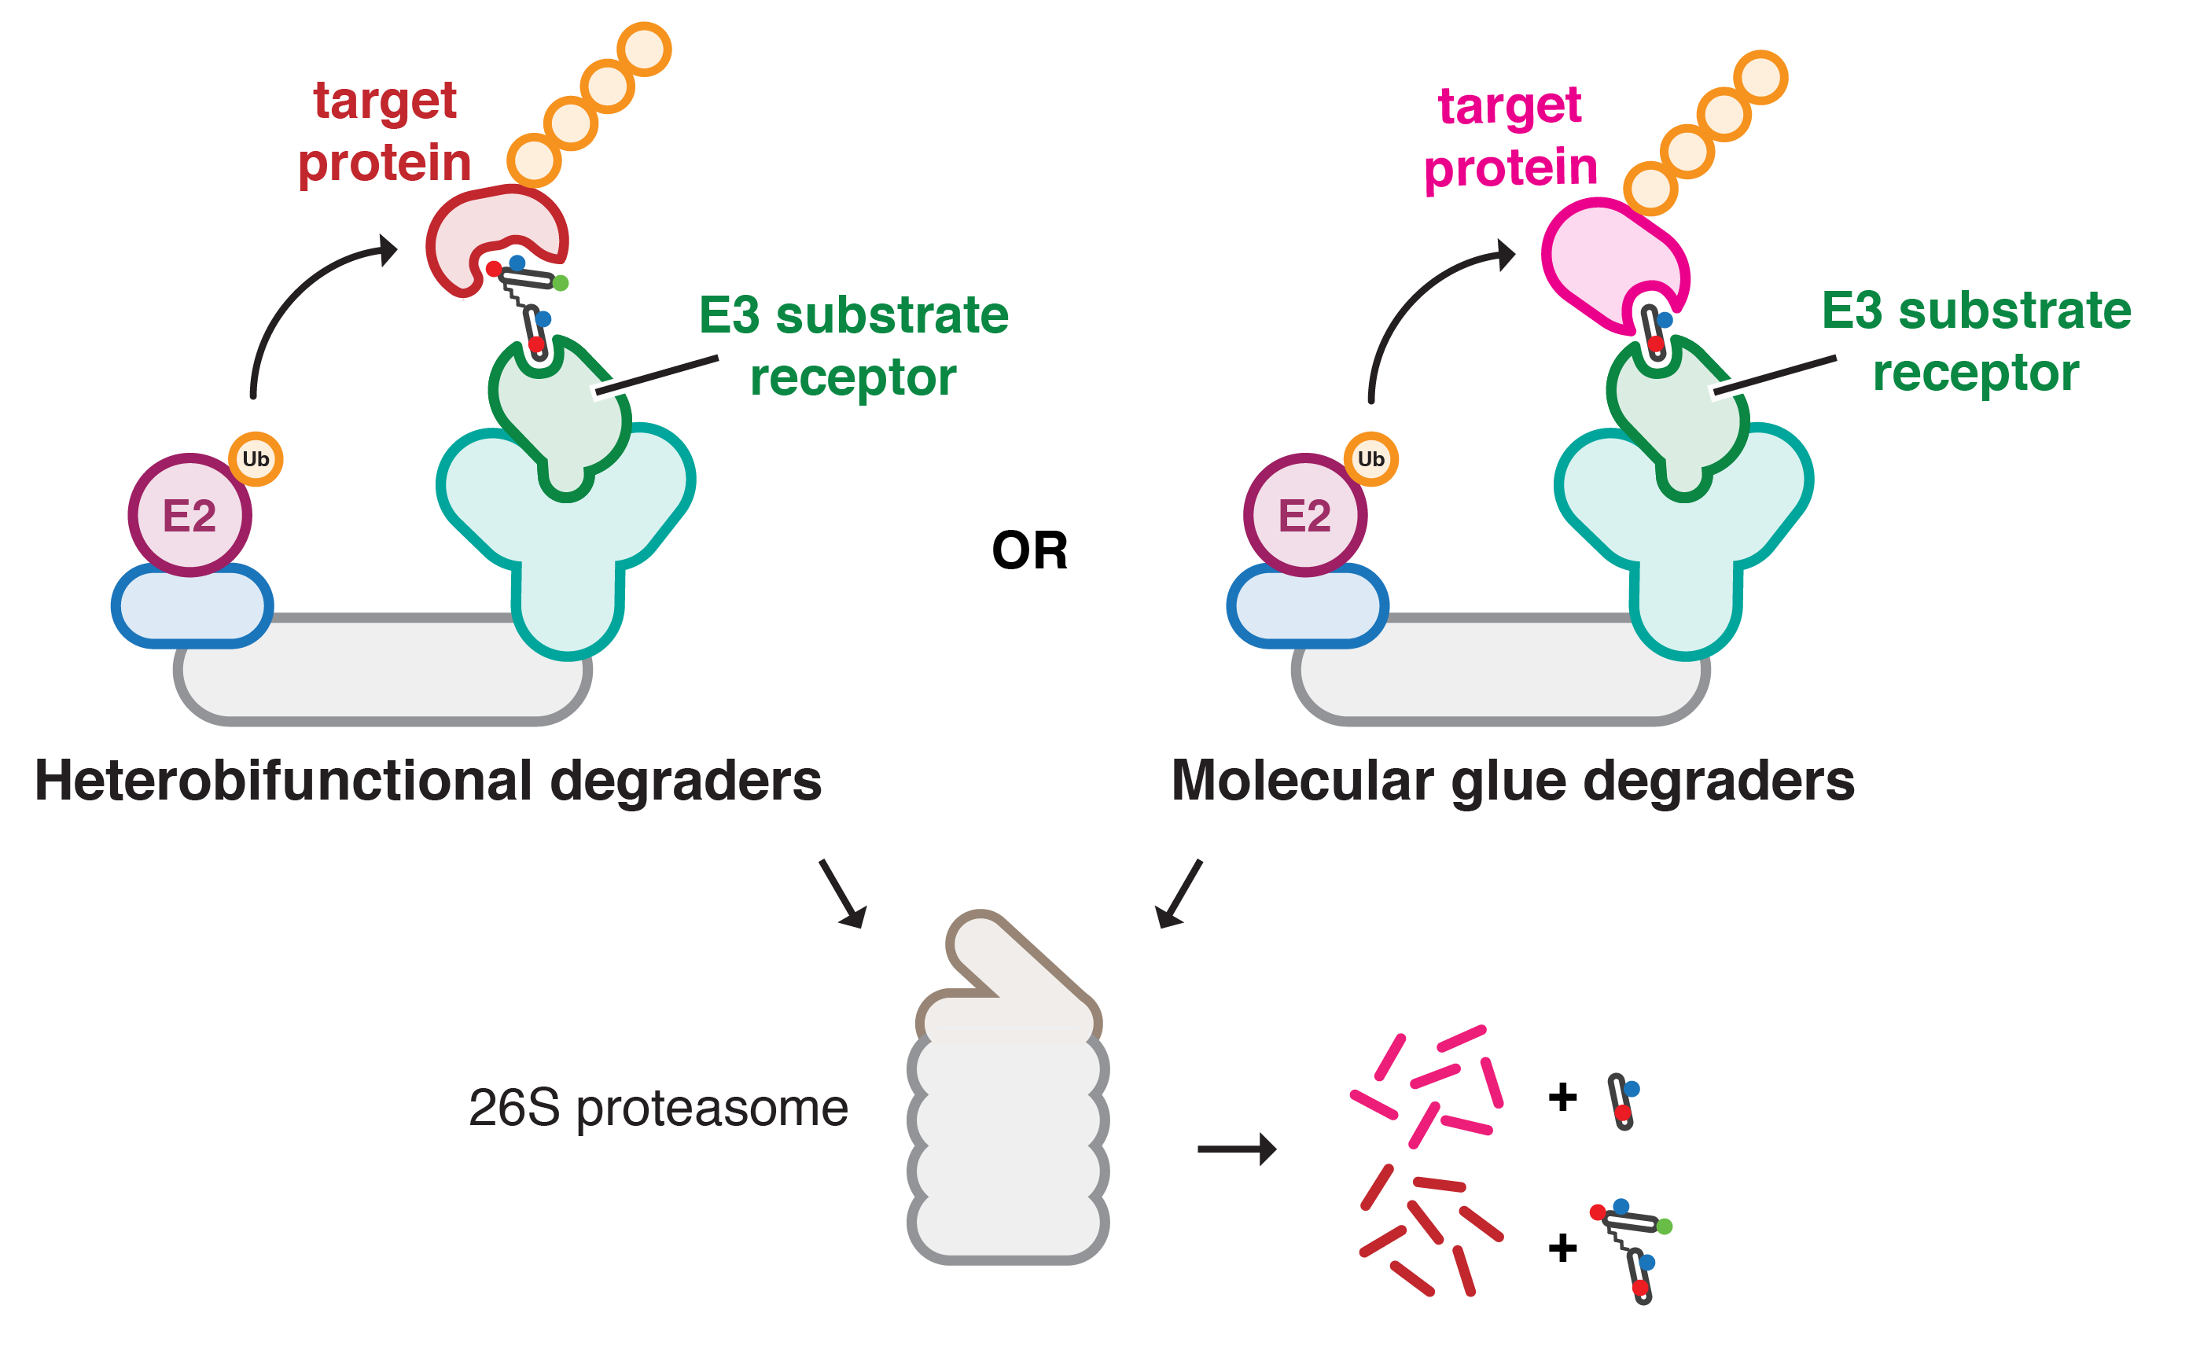
PROTAcs:
The two extremes of the
targeted protein degradation continuum
Rational design
Dependent on ligand availability
High(er) M_{W}
Serendipitous discovery
Less reliant on ligands/pockets
Small(er) and intrinsically more drug-like

Slide 6
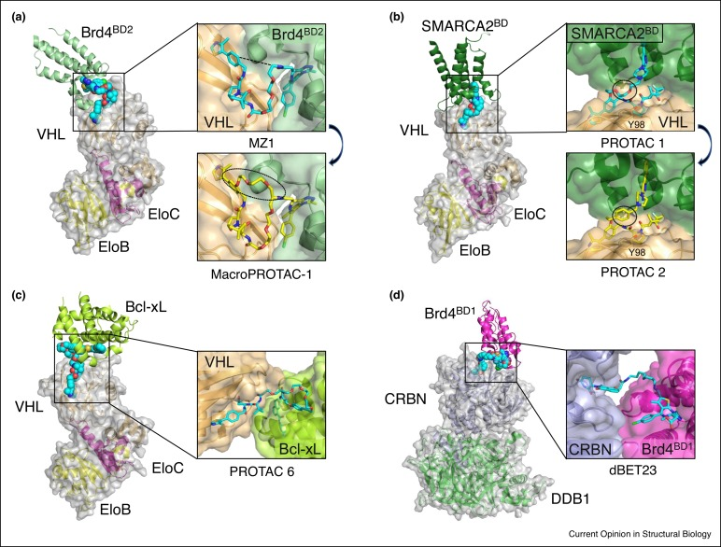
Protein-
Protein
Interaction
In
PROTACs
Ramachandran et al. (2020)
Notes:
https://doi.org/10.1016/j.sbi.2020.10.009

Slide 7
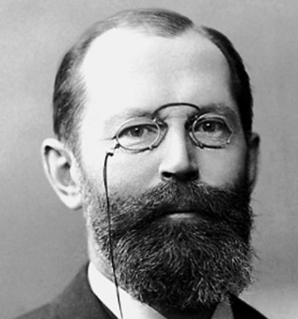
How can this be … ?

Slide 8
THERMO-
DYNAMIC
MODEL

Slide 9
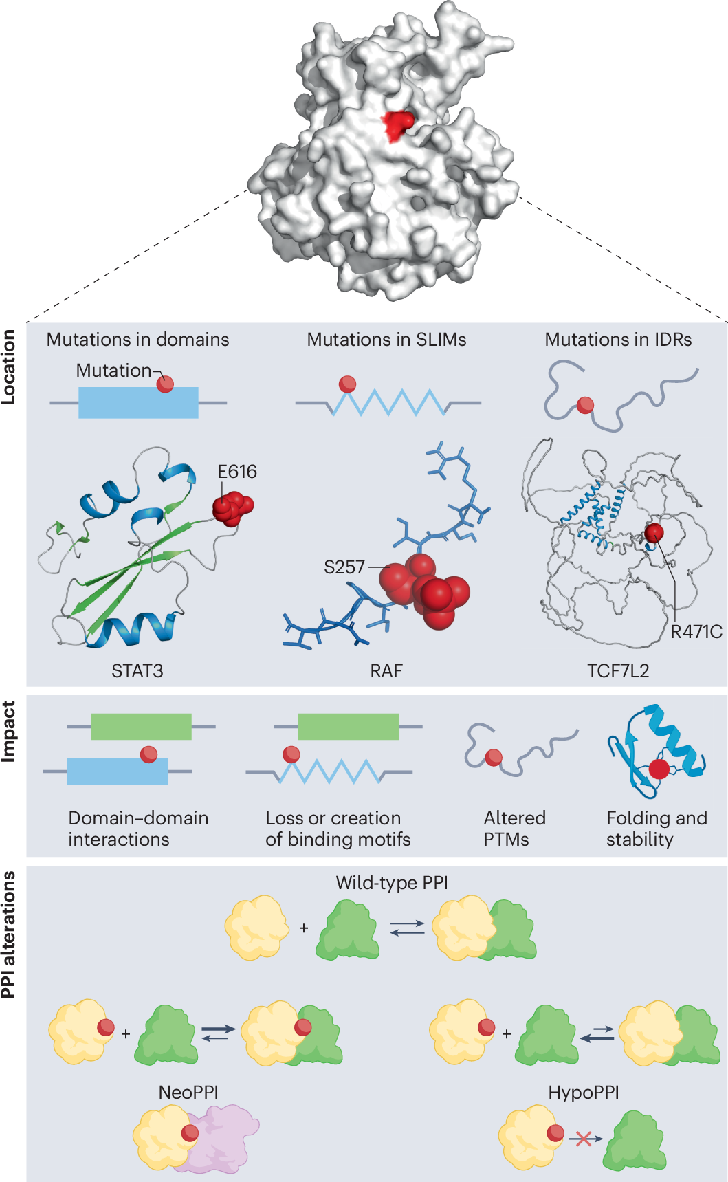
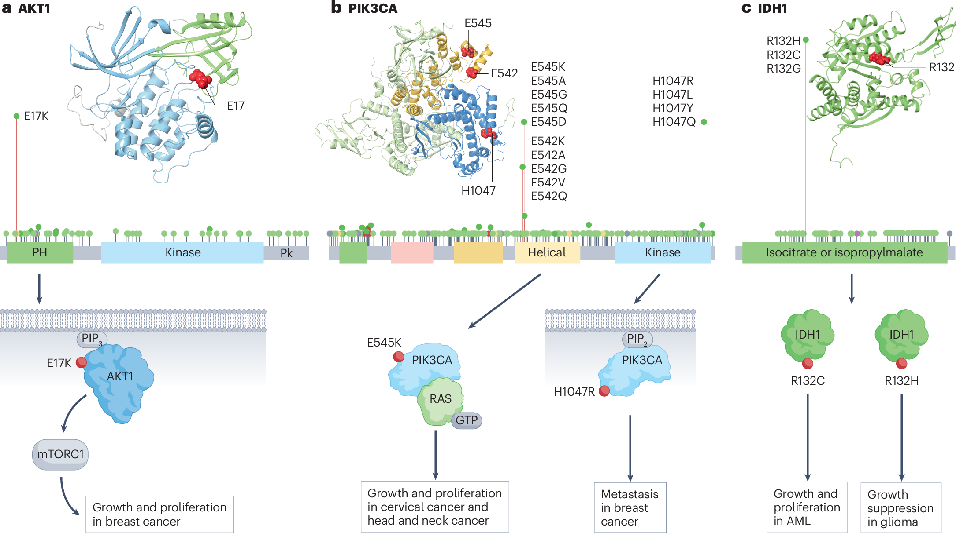
Most mutations are loss of function …
… but maybe not true for all mutations !?
Fu, Mo & Ivanov, Nat Rev Cancer (2025)
Notes:
https://www.nature.com/articles/s41568-024-00784-6

Slide 10
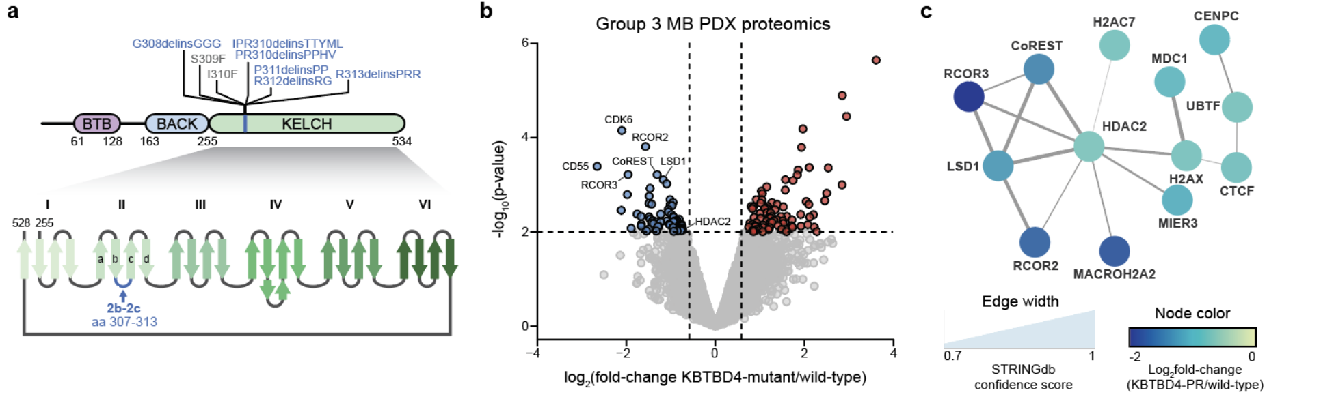
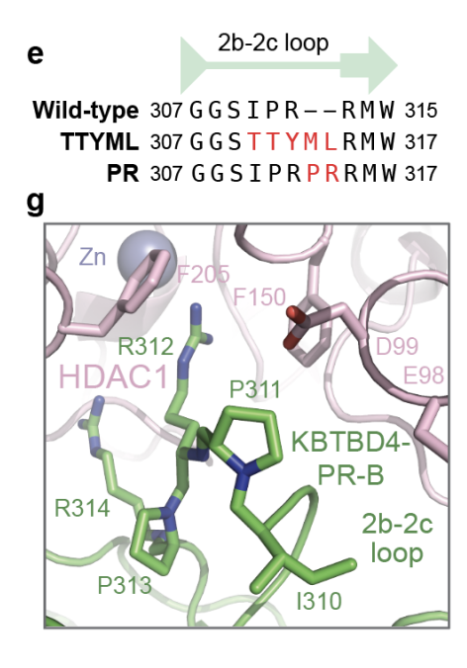
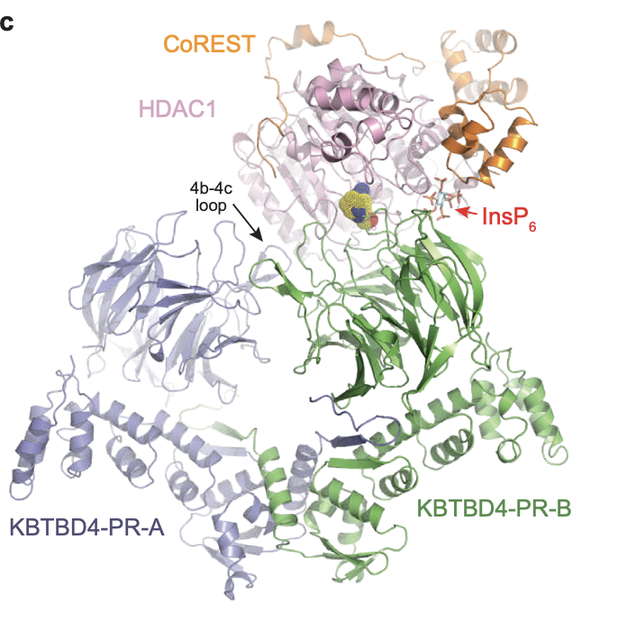
KBTBD4:
Gain-of-function by Cancer Mutations
Cancer Mutations
trigger CoREST degradation
The insertion mutation on the receptor
Is sufficient to bind COREST so tight
That it is degraded

Slide 11
KBTBD4:
Gain-of-function by Cancer Mutations
Cancer Mutations
trigger CoREST degradation
Xie, Zhang, Yeo, Lee et al., bioRxiv 2024
Notes:
https://www.biorxiv.org/content/10.1101/2024.05.14.593970v1.full.pdf

Slide 12
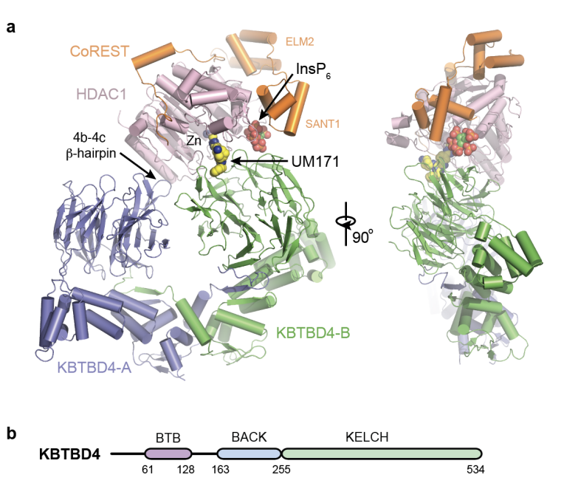
KBTBD4:
Gain-of-function by Cancer Mutations
UM171 molecular Glue degrader for COREST
Xie, Zhang, Yeo, Lee et al., bioRxiv 2024
Notes:
https://www.biorxiv.org/content/10.1101/2024.05.14.593897v1.full.pdf

Slide 13
THERMO-
DYNAMIC
MODEL

Slide 14
Many more
Unicorns
But how
To
Find
them?

Slide 15
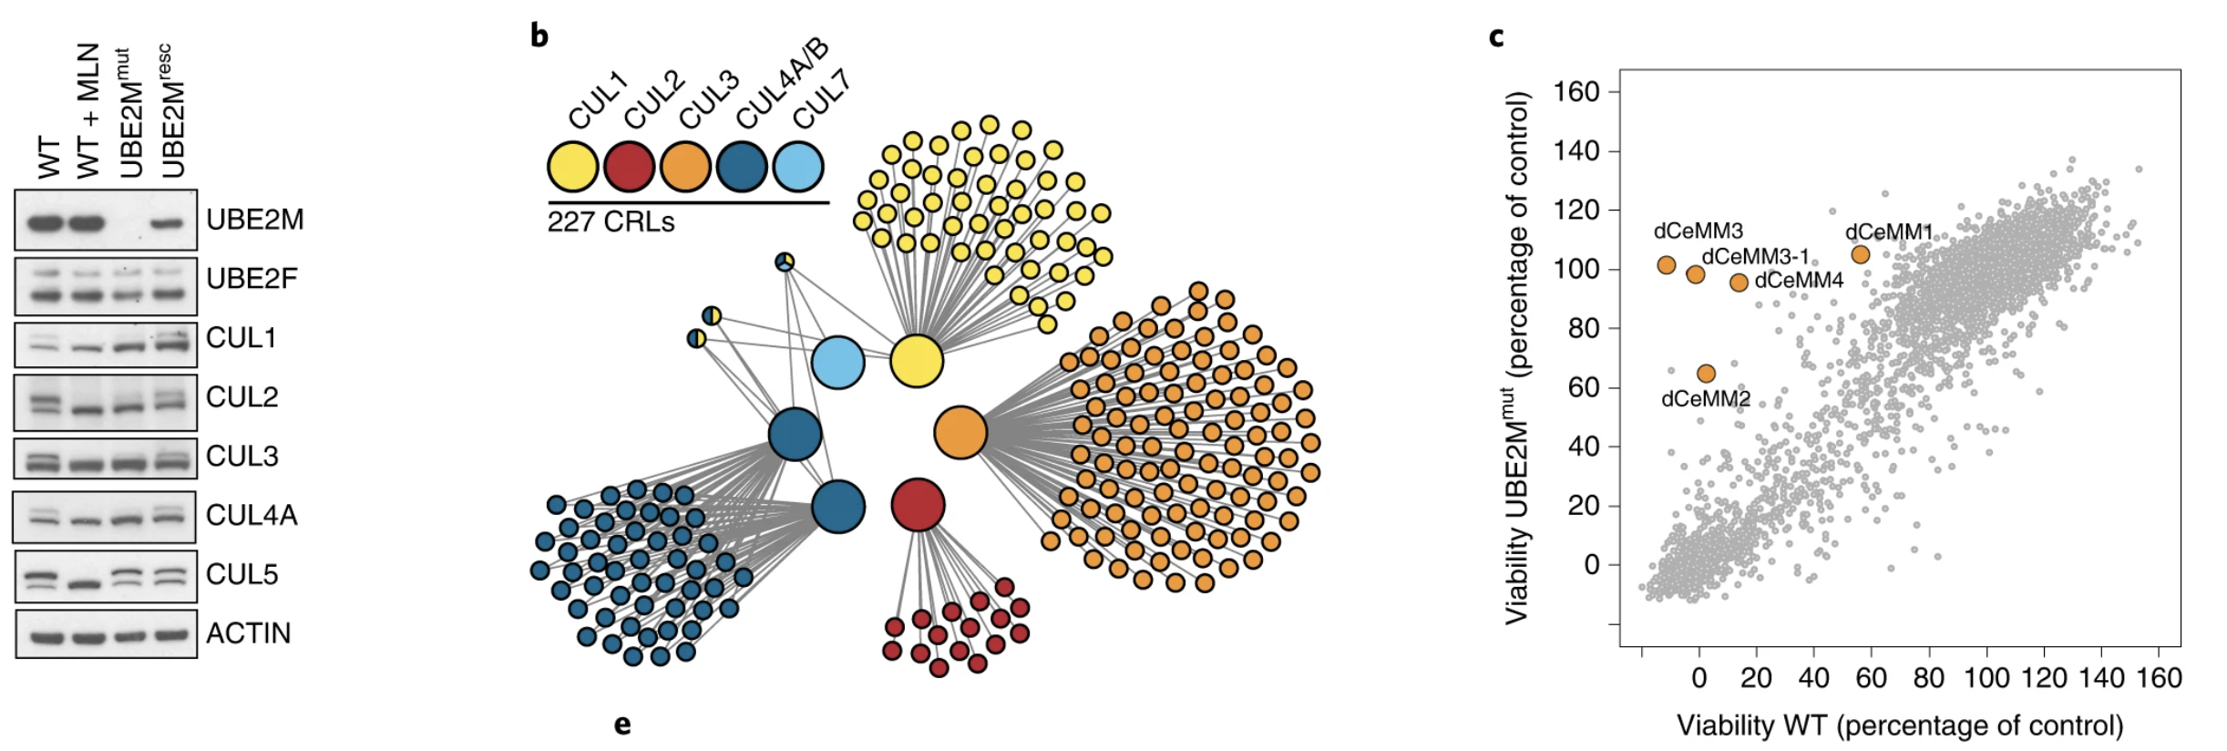
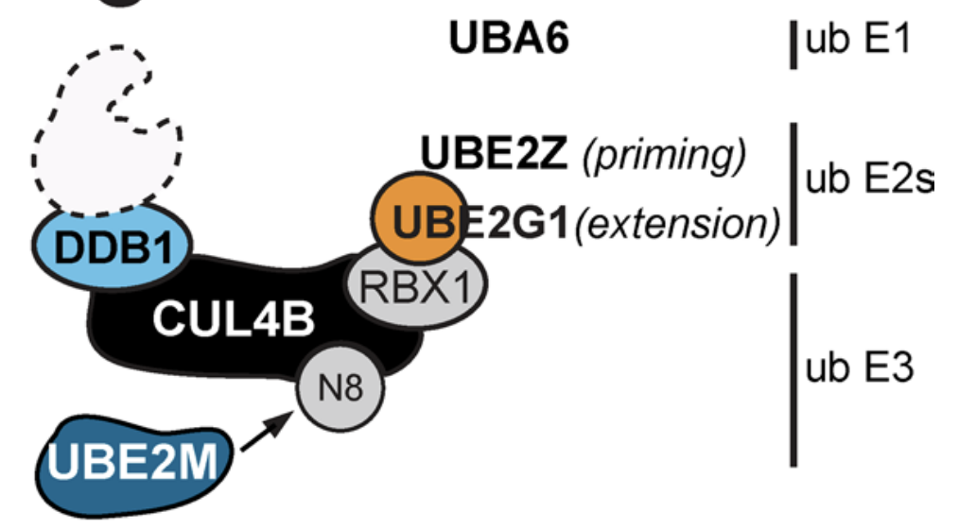
Screen for Cullin-based Molecular Glues
by Neddylation inhibition
Major-Ruiz et al. (2020)
Notes:
https://www.nature.com/articles/s41589-020-0594-x

Slide 16
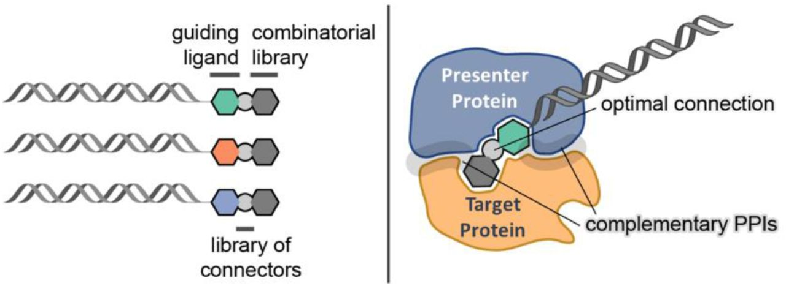
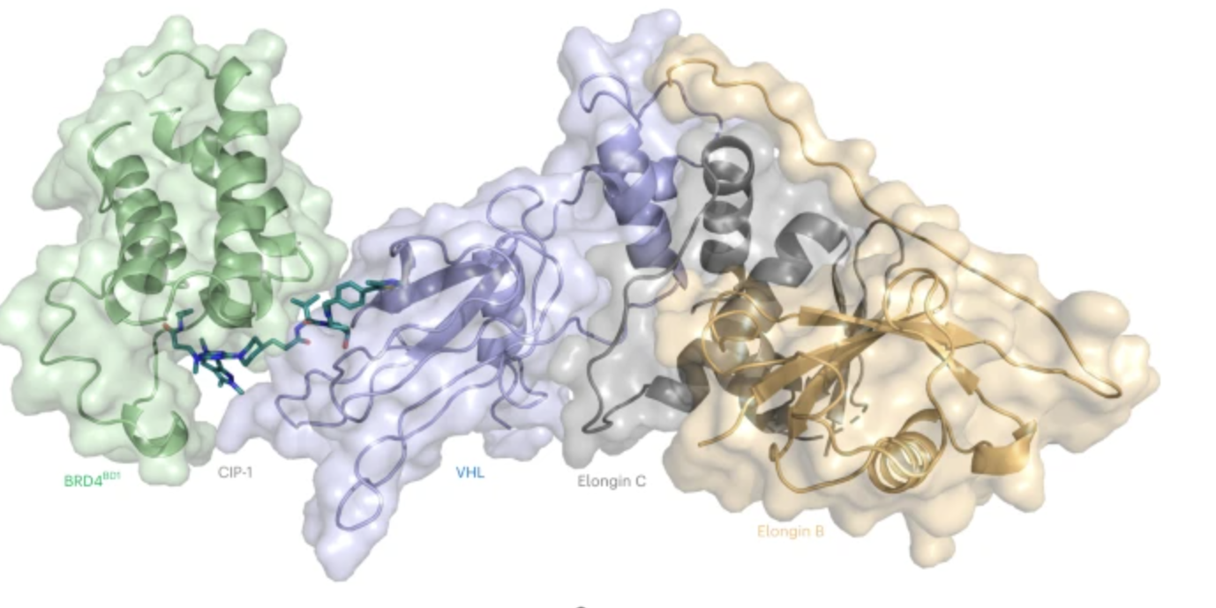
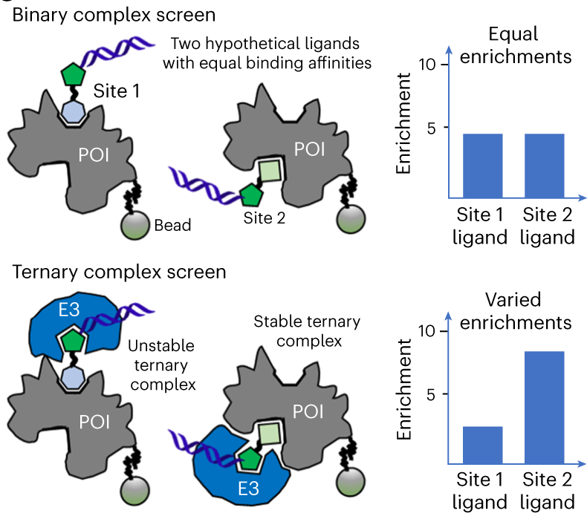
DEL Screen for Glues
Mason et al. (2023)
Notes:
DOI: 10.1038/s41589-023-01458-4

Slide 17
What is out of reach for degraders? (PROTACs & Molecular Glues)

Slide 18
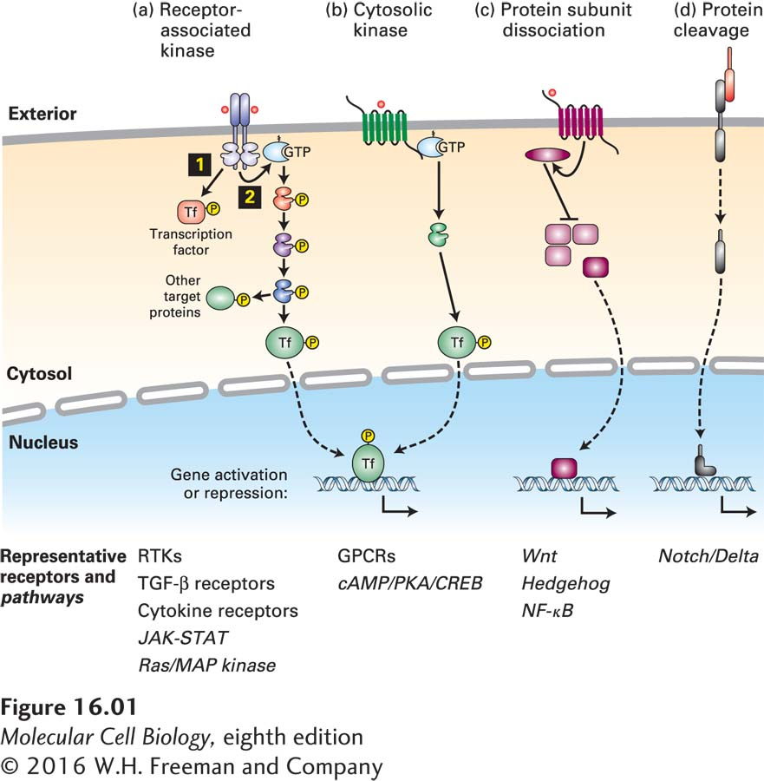
The challenges
What is “hard” to drug:
Transcription factors (unstructured)
Membrane proteins (agonists/antagonists)
Structural proteins without active site

Slide 19
What is out of reach for degraders? (PROTACs & Molecular Glues)
… when loss of function/degradation is not enough !?
What is still hard:
Fix posttranslational modifications
Stabilisation of proteins

Slide 20
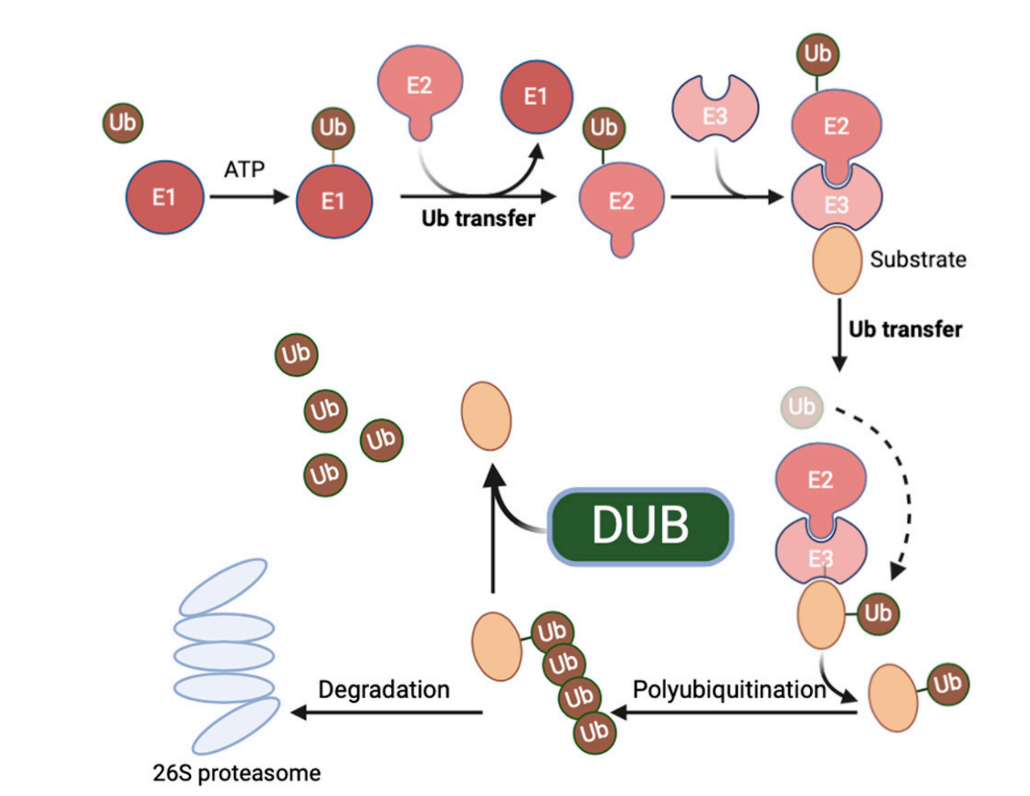

Slide 21
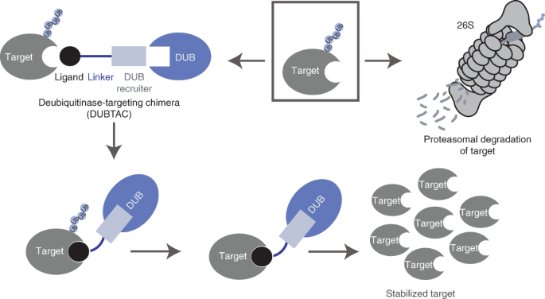
DUB-TACs
Active ubiquitination and degradation of proteins is the root cause of several classes of diseases, including many tumor suppressors in cancer (for example, TP53, CDKN1A, CDN1C and BAX), and mutated and misfolded proteins, such as ΔF508-cystic fibrosis transmembrane conductance regulator (CFTR) in cystic fibrosis or glucokinase in pancreatic cells in maturity-onset diabetes of the young type 2.
Henning et al. (2022)
Notes:
Active ubiquitination and degradation of proteins is the root cause of several classes of diseases, including many tumor suppressors in cancer (for example, TP53, CDKN1A, CDN1C and BAX), and mutated and misfolded proteins, such as ΔF508-cystic fibrosis transmembrane conductance regulator (CFTR) in cystic fibrosis or glucokinase in pancreatic cells in maturity-onset diabetes of the young type 2.
https://doi.org/10.1038/s41589-022-00971-2

Slide 22

Will it work?

Slide 23
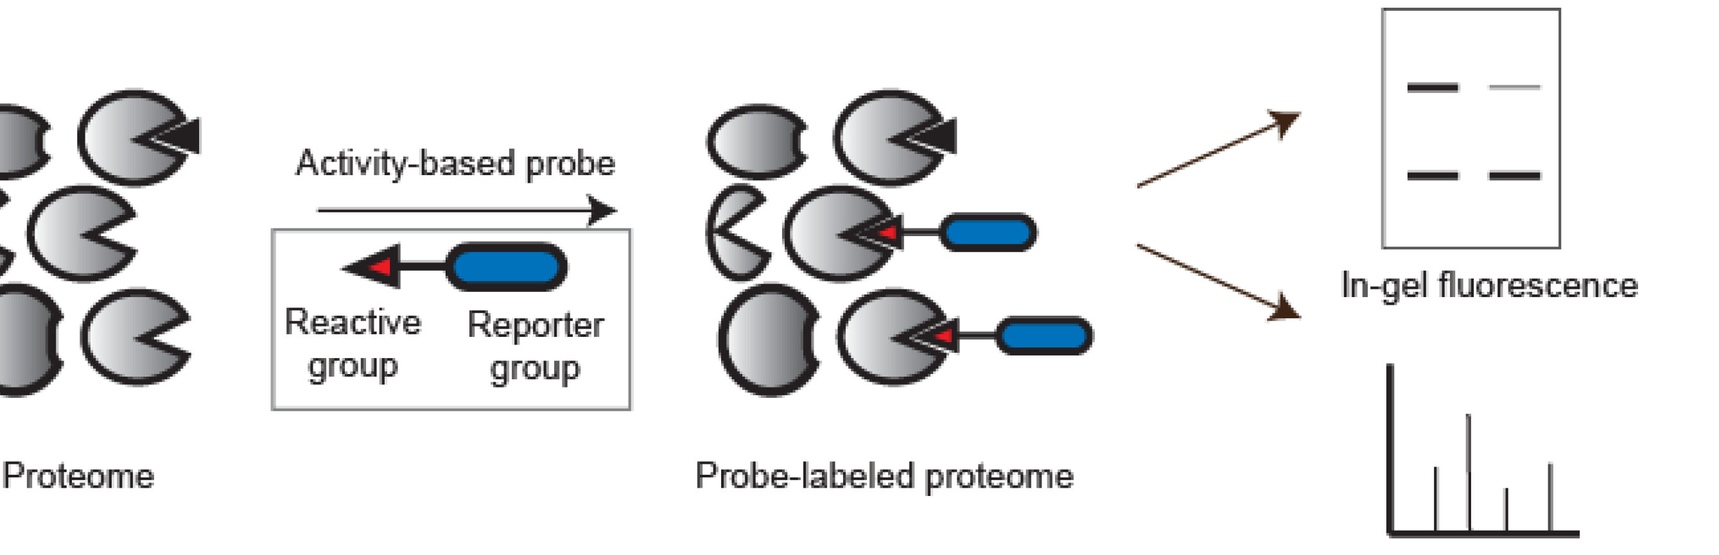
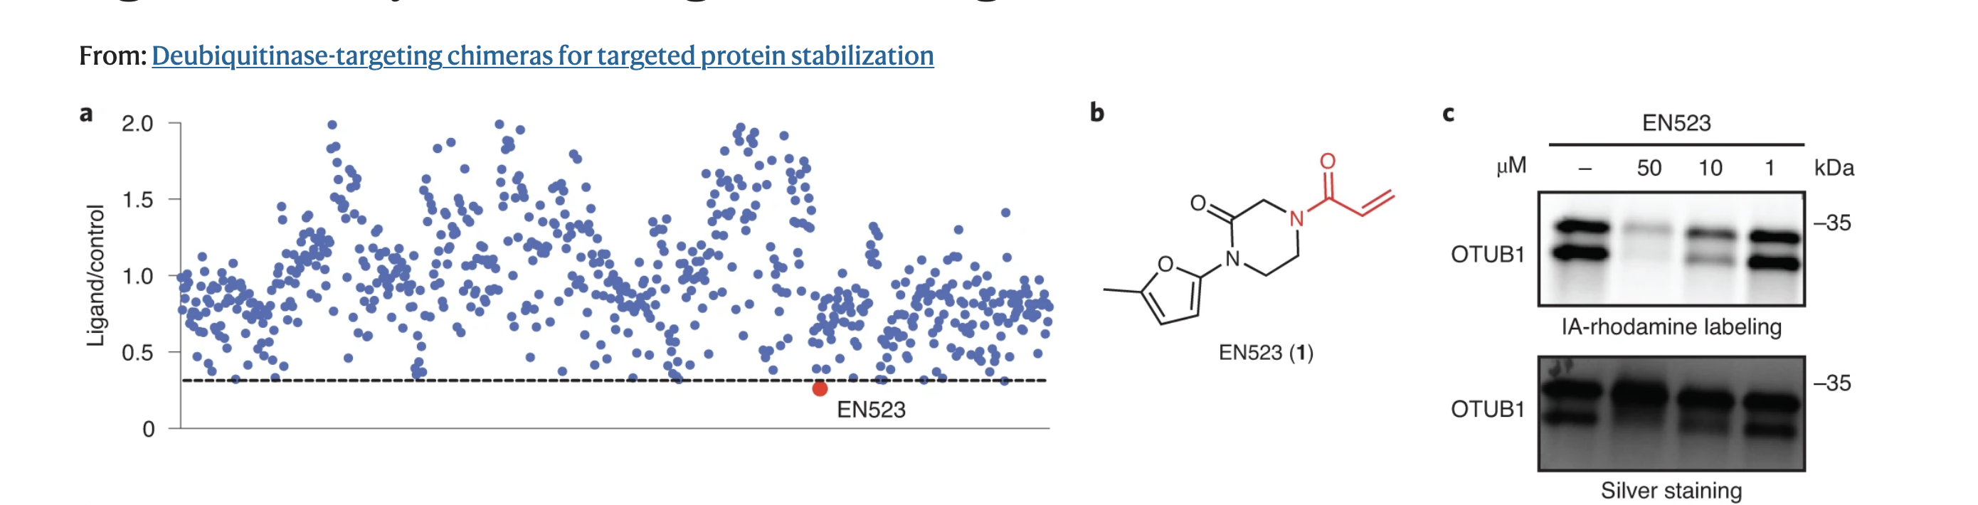
Find a ligand for a DUB (Activity-based protein profiling (ABPP)
DUB
Fluorescent
Reporter
Notes:
OTUB1 is a highly expressed DUB that specifically cleaves K48-linked polyubiquitin chains, the type of ubiquitin linkage that destines proteins for proteasome-mediated degradation, and C23 represents a known ubiquitin substrate recognition site that is distant from the catalytic C91 (Extended Data Fig. 1b)^{17,18,19,20}.

Slide 24
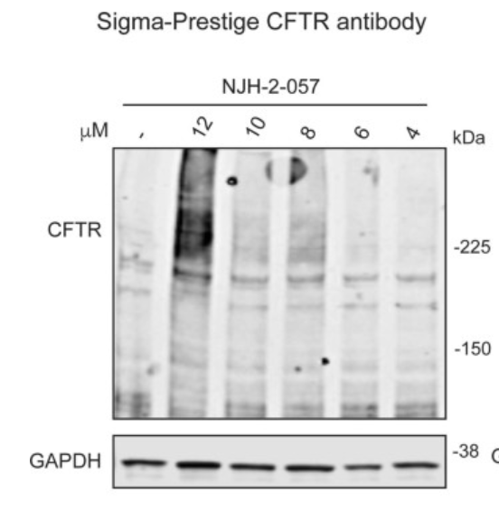
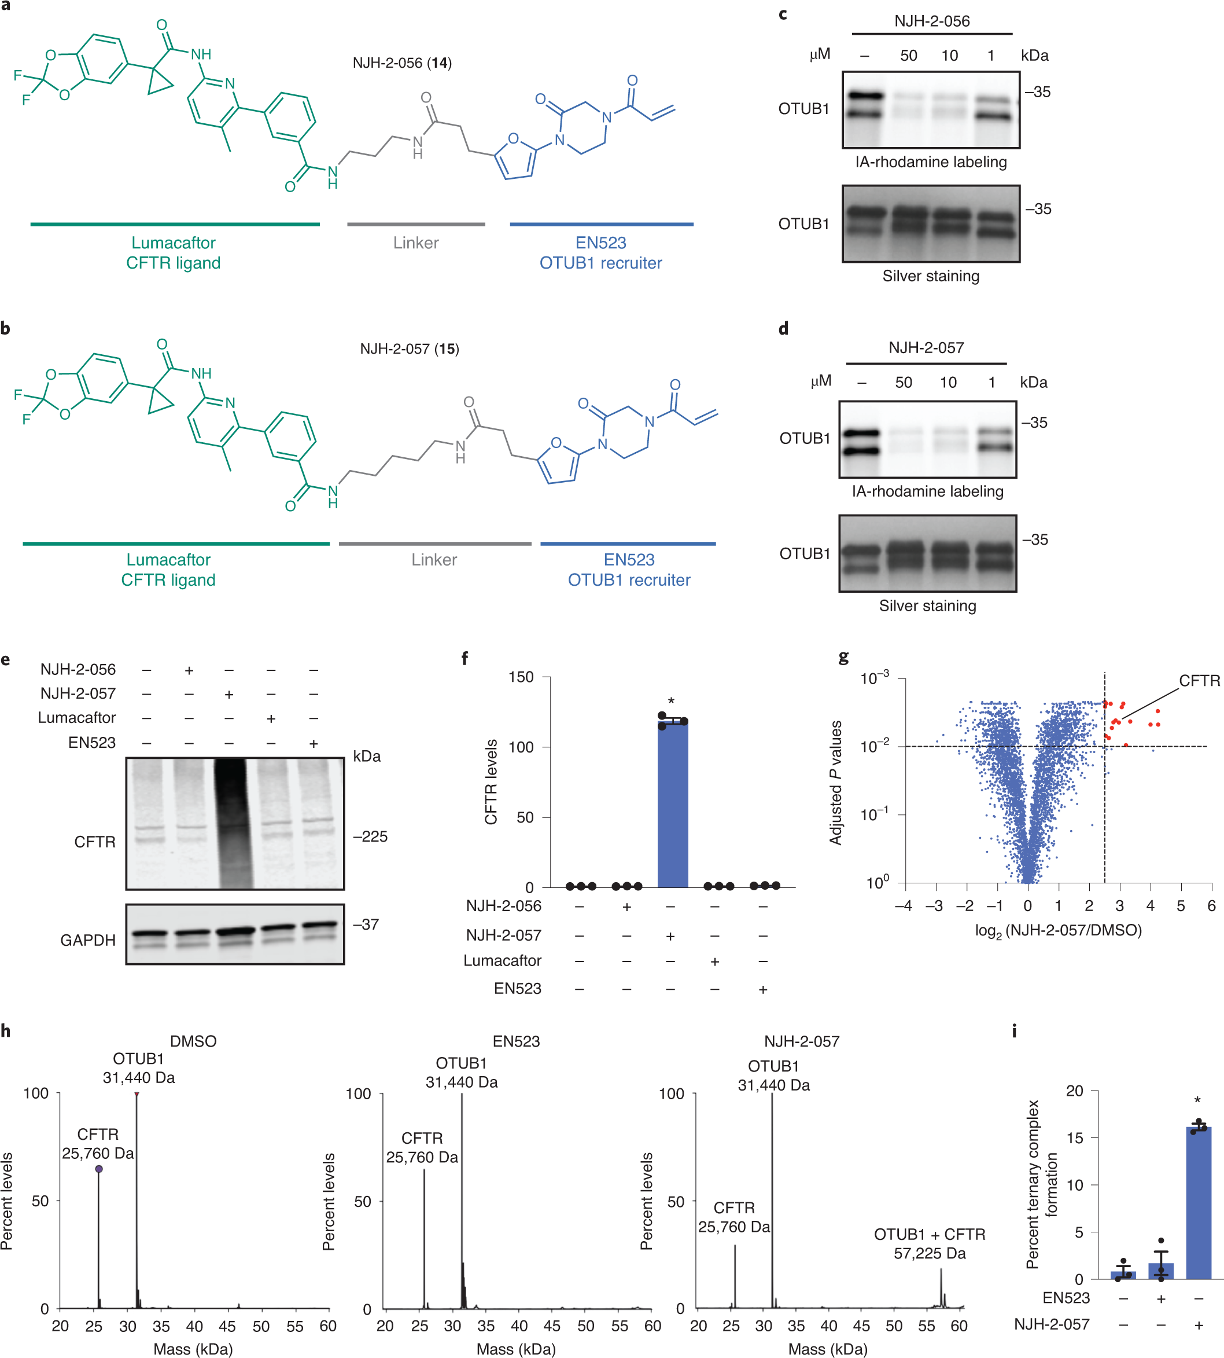
Proof of concept!?
Notes:
With this in mind, we synthesized DUBTACs linking the OTUB1 recruiter EN523 to the CFTR chaperone lumacaftor with two different C3 or C5 alkyl linkers, NJH-2-056 (14) and NJH-2-057 (15) (Fig. 3a,b). We confirmed that these two DUBTACs still engaged recombinant OTUB1 in vitro by gel-based ABPP (Fig. 3c,d). We used CFBE41o-4.7 human bronchial epithelial cells expressing ΔF508-CFTR, a human cystic fibrosis bronchial epithelial cell line, as a model system to test our DUBTACs. We first showed that EN523 did not alter OTUB1 protein levels in these cells (Extended Data Fig. 4a). We also demonstrated that the alkyne-functionalized EN523 probe NJH-2-075 still engaged OTUB1 in this cell line (Extended Data Fig. 4b). The DUBTACs were then tested in these cells alongside lumacaftor or EN523 treatment alone. Treatment with NJH-2-056, lumacaftor, or EN523 did not alter mutant CFTR levels; however, we observed a robust and significant increase in CFTR protein levels with NJH-2-057 treatment (Fig. 3e,f). This stabilization was dose responsive and time dependent (Extended Data Fig. 5). We further confirmed that the stabilized protein was CFTR using three additional commercially available CFTR antibodies (Extended Data Fig. 6) and showed that the DUBTAC-stabilized CFTR band was attenuated following CFTR knockdown (Extended Data Fig. 7).

Slide 25
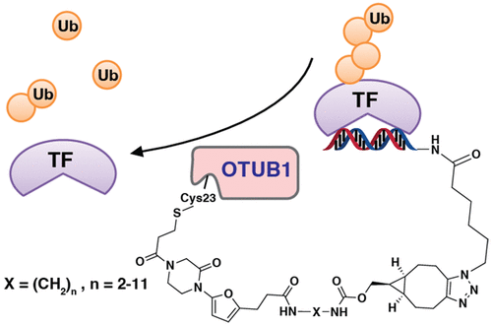
Dream big!
Remember: the most interesting/most targets do not have ligands (and if they have
ligands they are likely inhibitors); this is
particularly true for transcription factors
Liu et al. (2022)
Notes:
doi: 10.1021/jacs.2c04824

Slide 26
DUBTac
The GOOD:
- One of the few technologies to stabilise a target (and not degrade it)
The BAD:
- Not very many DUB ligands
The UGLY:
- These small molecules are HUGE! And not (yet) drug-like ☹

Slide 27
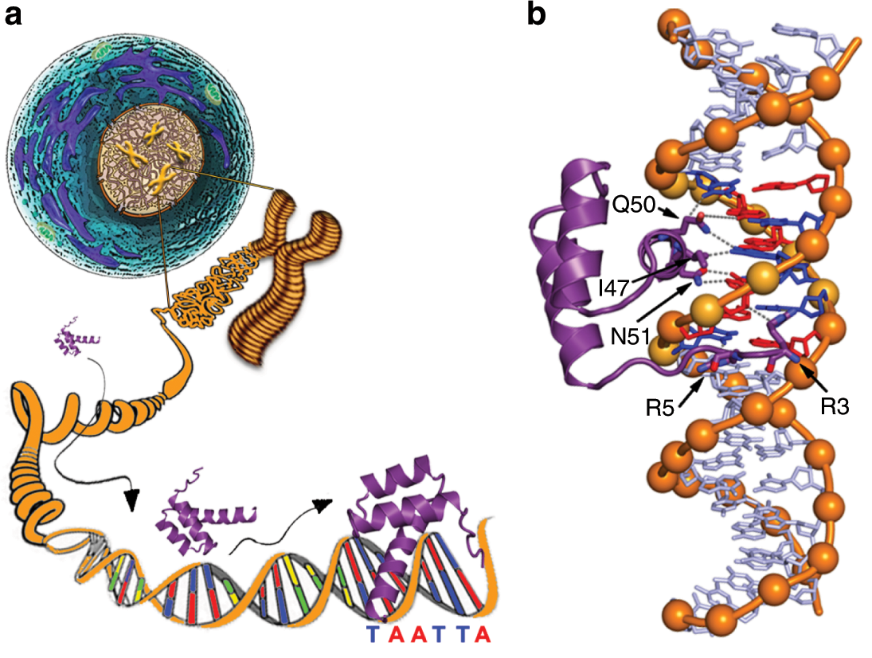

Slide 28
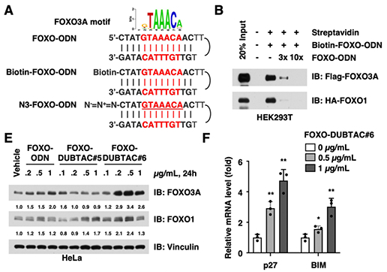
FOXO-DUBTAC stabilises FOXA1

Slide 29
DUBTac
The CLEVER:
- don’t need a ligand for the TF (yeah!!!) … well specificity is not great …
… compound even bigger (oh no!) …. and even less drug-like ☹☹
The GOOD:
- One of the few technologies to stabilise a target (and not degrade it)
The BAD:
- Not very DUB ligands
The UGLY:
- These small molecules are HUGE! And not yet drug-like

Slide 30
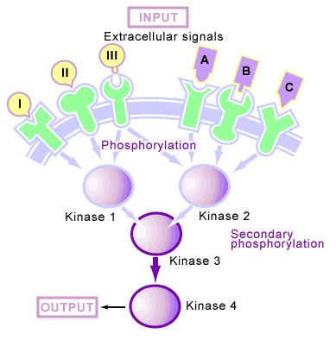
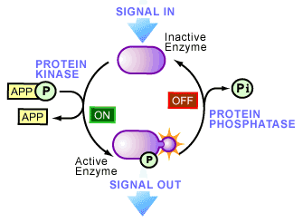
https://www.scq.ubc.ca/protein-phosphorylation-a-global-regulator-of-cellular-activity/

Slide 31
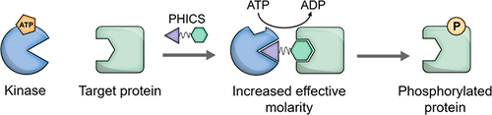
Phosphorylation-inducing chimeric molecules (PHICs) and phosphorylation targeting chimeras (PHOSTACs)

Slide 32
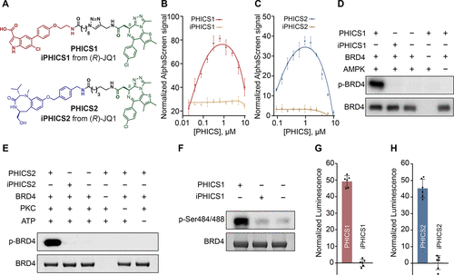
Phosphorylation-inducing chimeric molecules (PHICs) and phosphorylation targeting chimeras (PHOSTACs)
Siriwardena et al. (2020)
Notes:
https://dx.doi.org/10.1021/jacs.0c05537?ref=pdf

Slide 33
Phosphorylation-inducing chimeric molecules (PHICs) and phosphorylation targeting chimeras (PHOSTACs)
Kinase:
AMPK
Kinase:
PKC
Effector: BRD4
in vitro
Notes:
https://dx.doi.org/10.1021/jacs.0c05537?ref=pdf

Slide 34
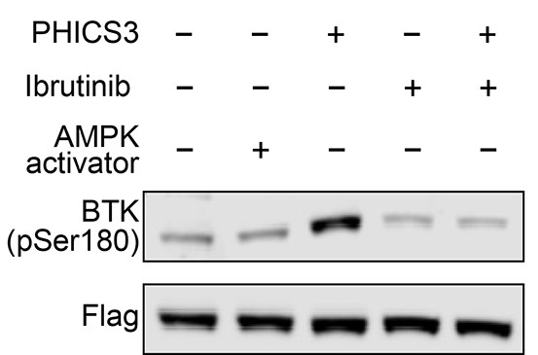
Phosphorylation-inducing chimeric molecules (PHICs) and phosphorylation targeting chimeras (PHOSTACs)
BTK (Ibrutinib
Known BTK inhibitor)
AMPK
(kinase activator)
Siriwardena et al. (2020)
In cellulo
Notes:
https://dx.doi.org/10.1021/jacs.0c05537?ref=pdf

Slide 35
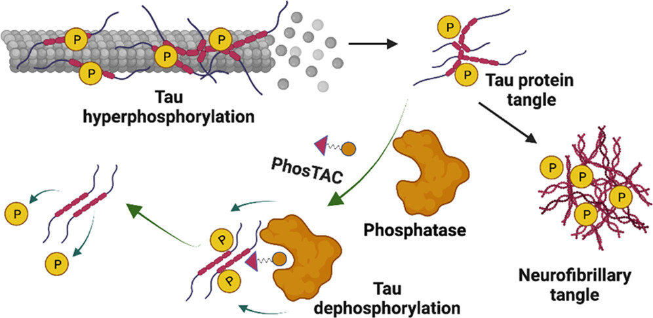
PHOSTAC (Phosphorylation Targeting Chimera)
Microtubule-associated protein tau is essential for microtubule assembly and stabilization. Hyperphosphorylation of the microtubule-associated protein tau plays an important pathological role in the development of Alzheimer’s disease and other tauopathies. In vivo studies using kinase inhibitors suggest that reducing tau phosphorylation levels has therapeutic potential; however, such approaches showed limited benefits.
Hu et al. (2023)
Notes:
Microtubule-associated protein tau is essential for microtubule assembly and stabilization. Hyperphosphorylation of the microtubule-associated protein tau plays an important pathological role in the development of Alzheimer’s disease and other tauopathies. In vivo studies using kinase inhibitors suggest that reducing tau phosphorylation levels has therapeutic potential; however, such approaches showed limited benefits. We sought to further develop our phosphorylation targeting chimera (PhosTAC) technology to specifically induce tau dephosphorylation. Herein, we use small molecule-based PhosTACs to recruit tau to PP2A, a native tau phosphatase. PhosTACs induced the formation of a stable ternary complex, leading to rapid, efficient, and sustained tau dephosphorylation, which also correlated with the enhanced downregulation of tau protein. Mass spectrometry data validated that PhosTACs downregulated multiple phosphorylation sites of tau. We believe that PhosTAC possesses several advantages over current strategies to modulate tau phosphorylation and represents a new avenue for disease-modifying therapies for tauopathies.
https://pubs.acs.org/action/showCitFormats?doi=10.1021/jacs.2c11706&ref=pdf

Slide 36
DUBTac PHOSTAC
The GOOD:
- One of the few technologies to stabilise a target (and not degrade it)
The BAD:
- Not very many DUB ligands kinase ligands that do activate (not inhibit)
The UGLY:
- These small molecules are HUGE! And not yet drug-like

Slide 37
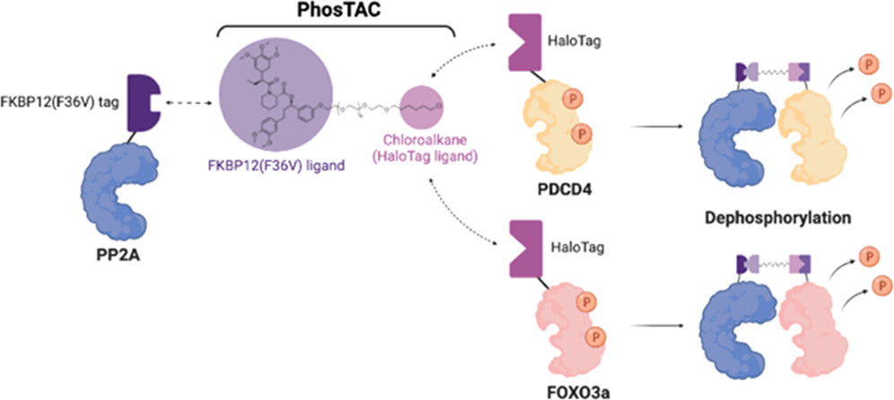
… but what to do if there is no ligand for the major phosphatase (PP2A)?
Tau

Slide 38
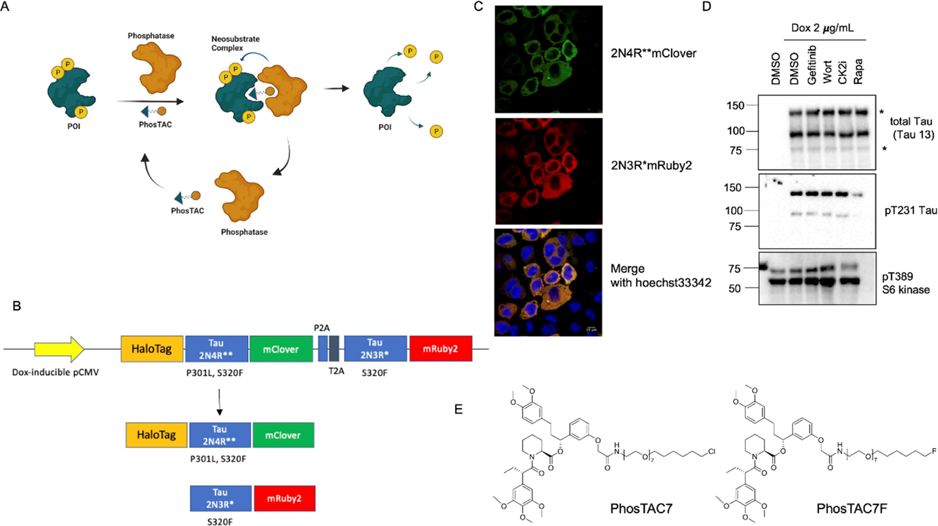

Slide 39
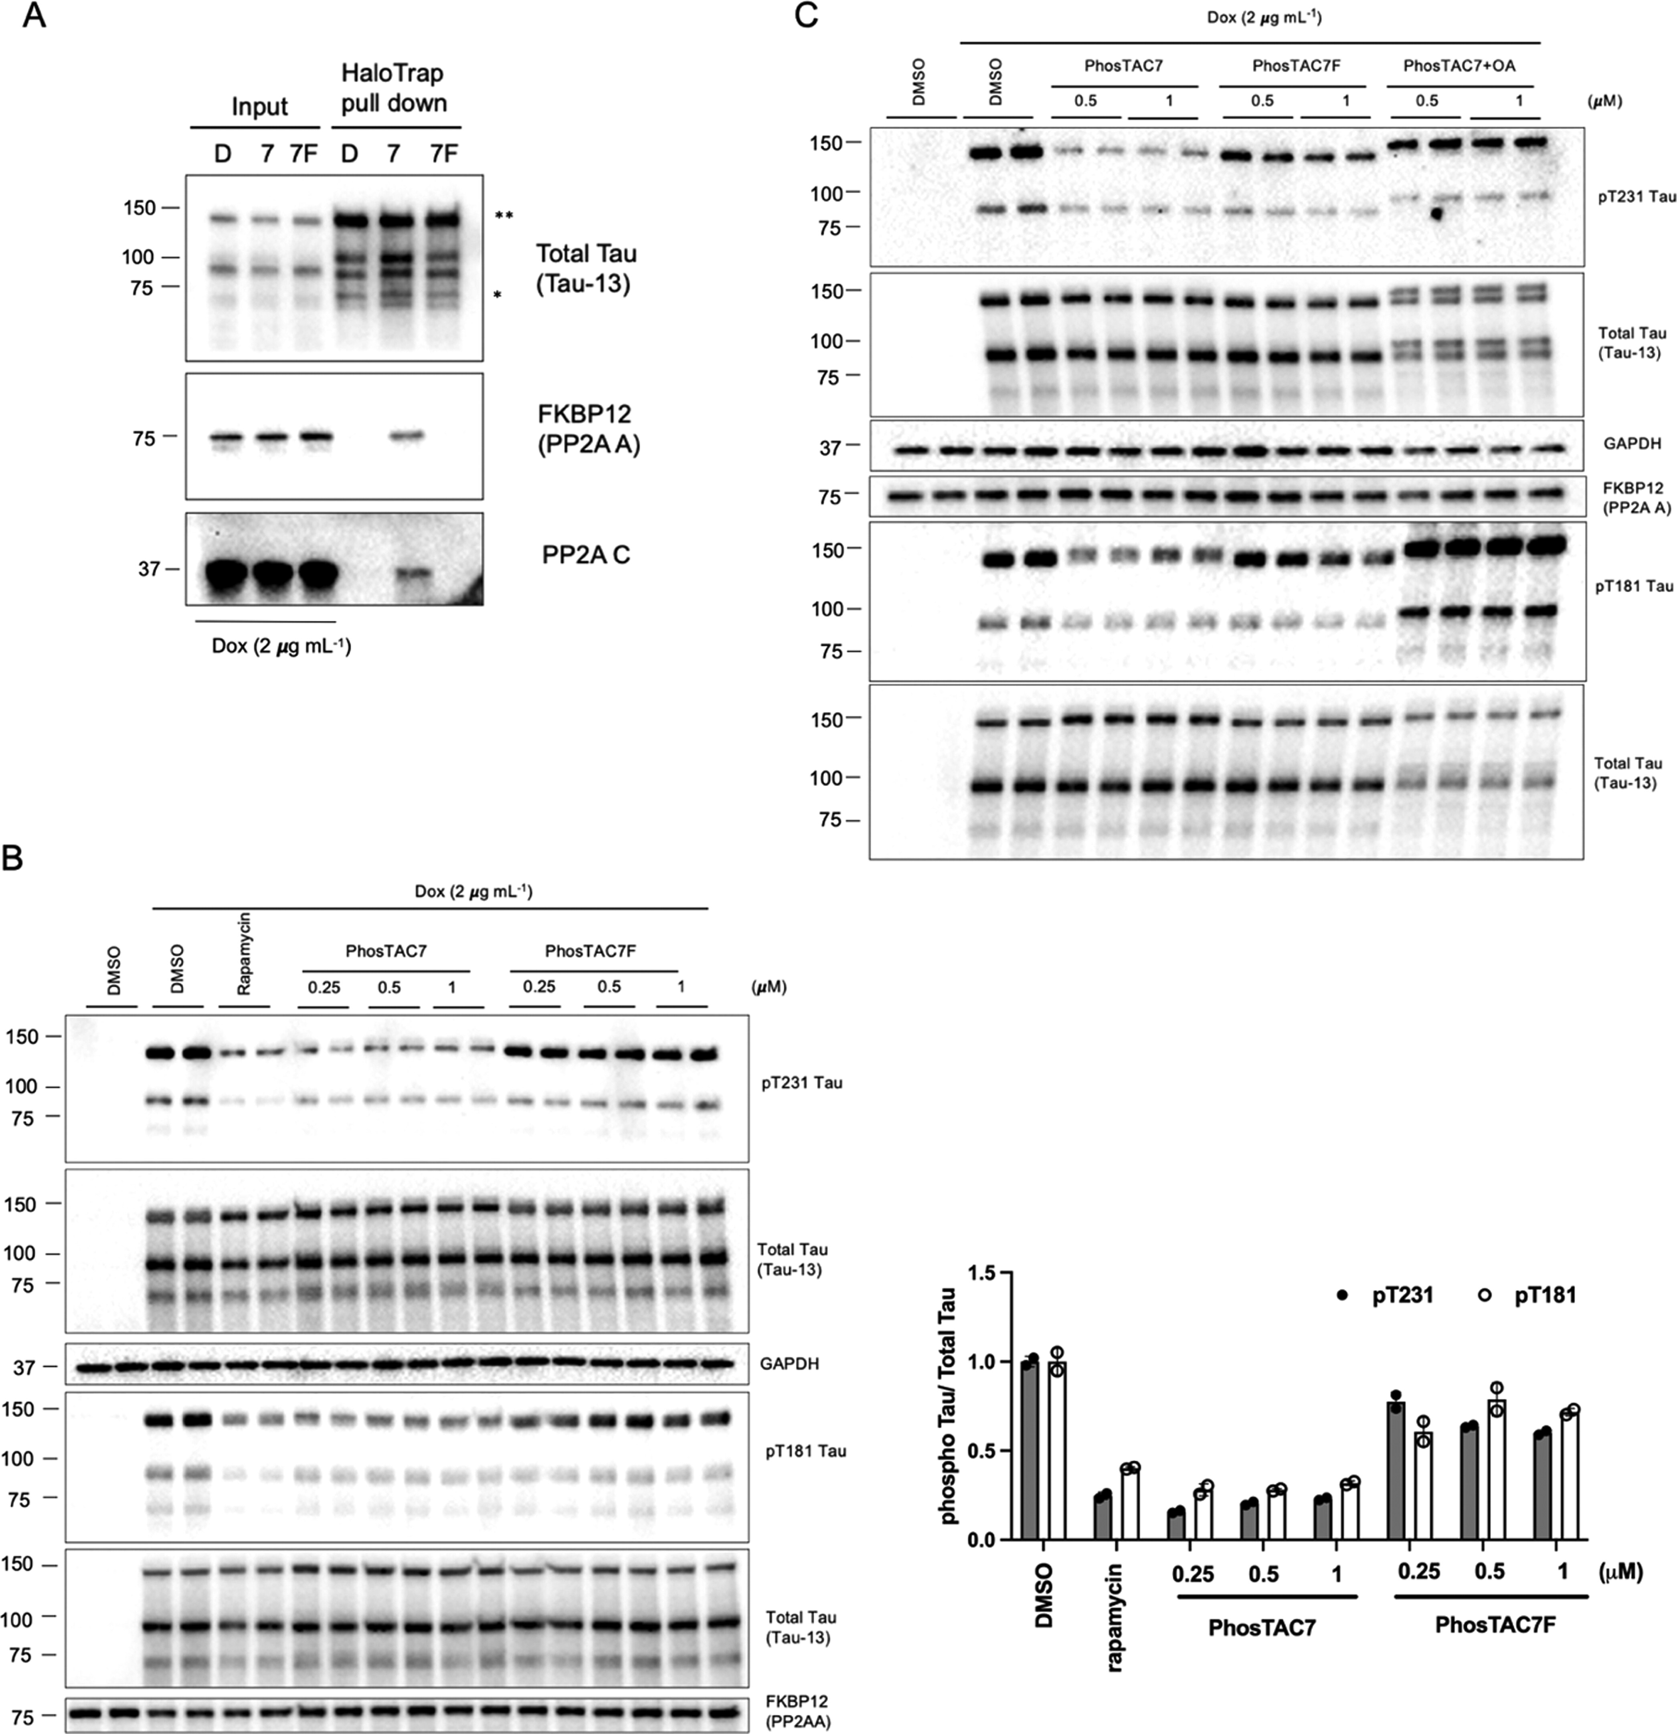
There are no ligands for PP2A
so they used FKBP12F36V-PP2A

Slide 40
There are also Acetylation-Targeting Chimera (AceTAC)
… but I think you get the idea!

Slide 41
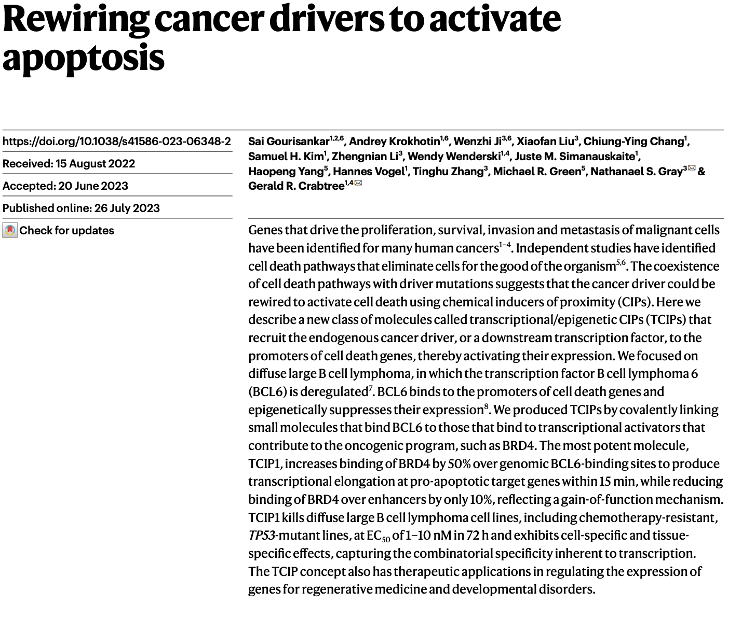
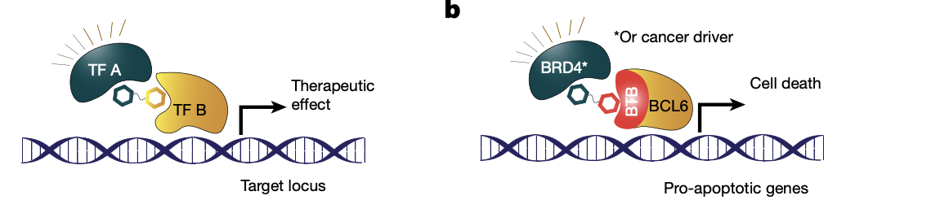
TCIPs (transcriptional/epigenetic chemical inducers of proximity)

Slide 42
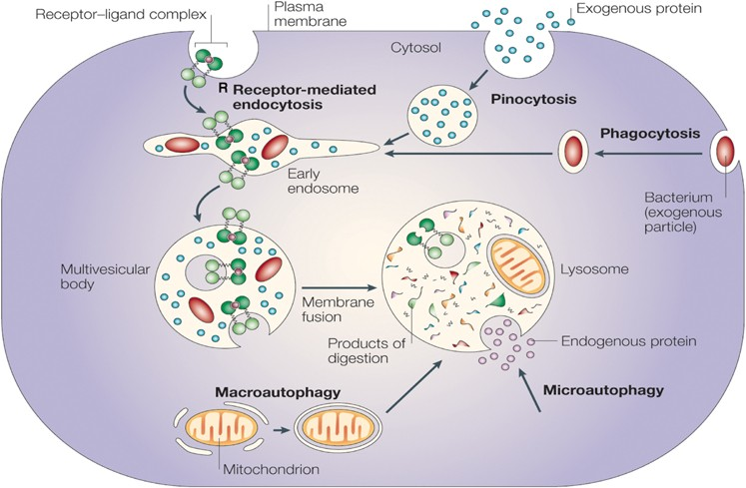

Slide 43
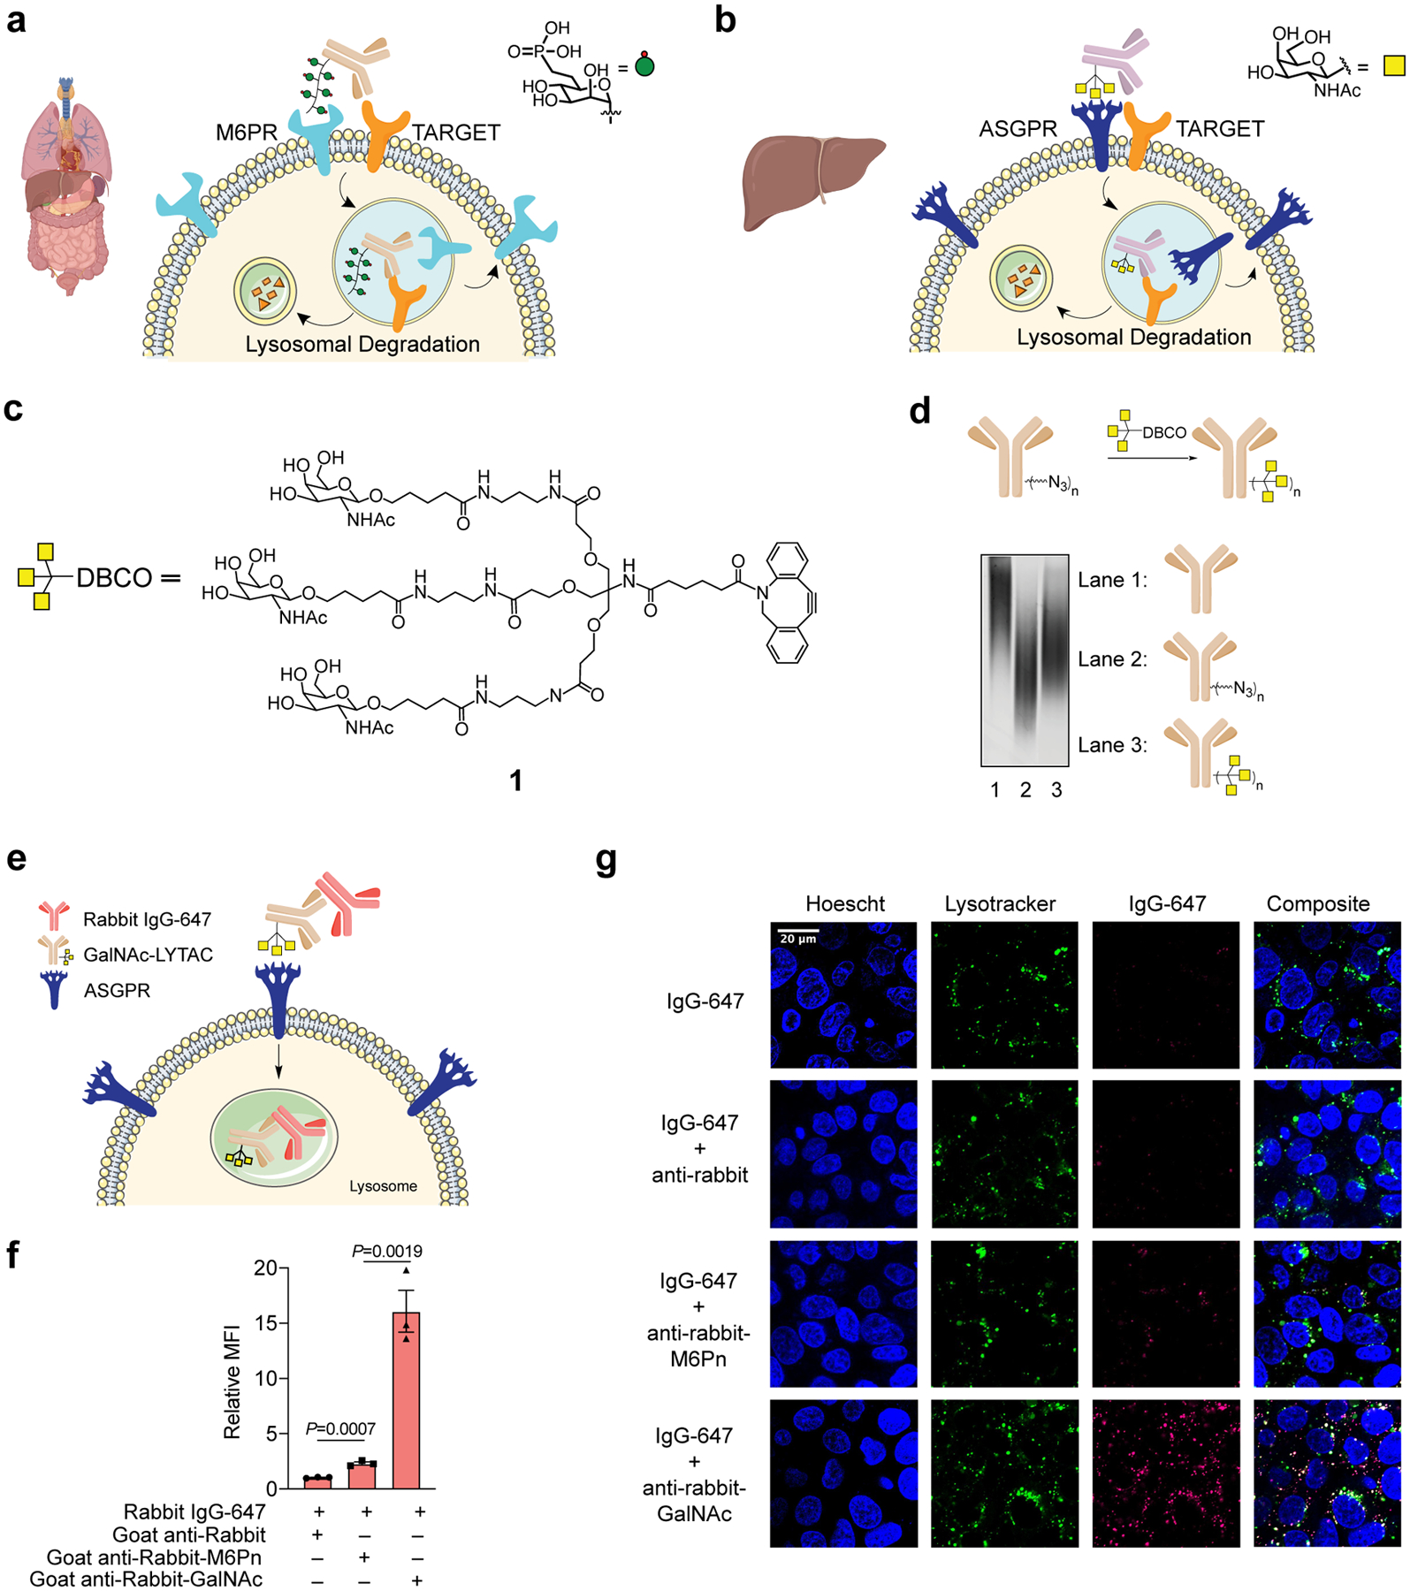
LYTACs (Lysosome Targeting Chimeras)

Slide 44
Receptors used for LYTACs
Mannose-6-phosphate receptor (CI-M6PR) or transferrin receptor (TfR)
LYTACs are particularly promising for tackling diseases involving aberrant surface proteins, such as certain types of cancer and autoimmune diseases.
For example, they have been used to degrade programmed death ligand 1 (PD-L1), an important immune checkpoint protein implicated in cancer immunotherapy, demonstrating effects similar to immune checkpoint inhibitors like anti-PD-L1 antibodies (Du et al., 2024; Su et al., 2024).

Slide 46
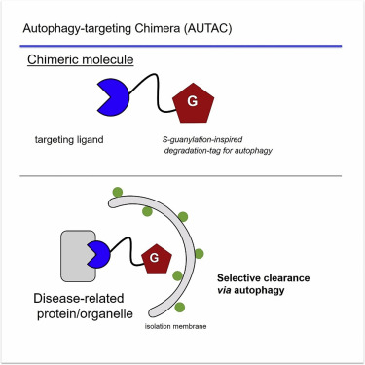
AUTACs
AUTACs (Autophagy Targeting Chimeras) harness autophagy to degrade aggregated proteins, organelles, or pathogens in the lysosome – targets typically too large for the ubiquitin-proteasome system. AUTACs tag substrates with an "S-guanylation" marker, promoting Lys63-linked polyubiquitination recognized by cellular autophagy receptors, which then recruit the autophagosome to degrade these targets (Takahashi et al., 2019; Takahashi et al., 2023). By fusing the S-guanylation tag with biguanide (metformin) as a mitochondrial targeting signal, Vatté et al. successfully induced mitophagy leading to cell death in cancer cells (Vatte et al., 2024). AUTAC-Biguanide has a significantly lower EC50 compared to metformin, highlighting its antiproliferative potential for cancer therapies. There were additional approaches, e.g., by using LC3/GABARAP binders to induce proximity of substrates to the autophagy-lysosome system. Yet, these approaches are till now without a significant success (Schwalm et al., 2024; Xue et al., 2023).

Slide 47
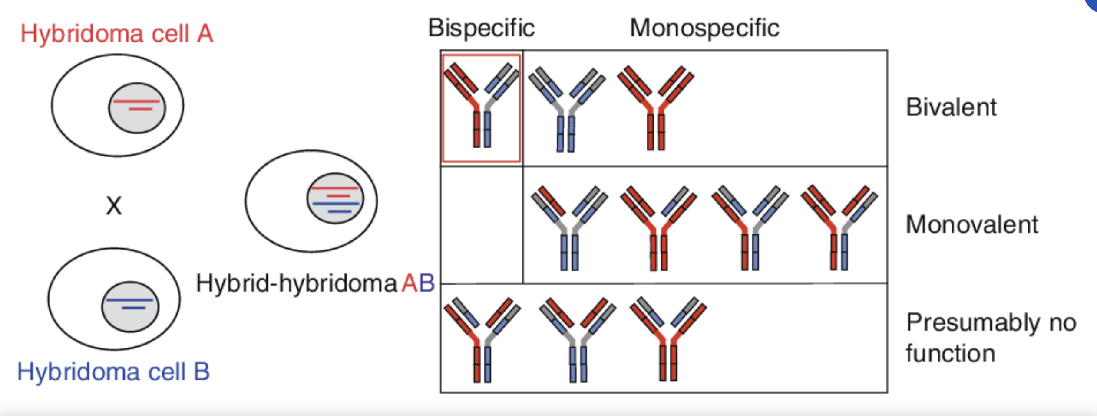
https://www.semanticscholar.org/paper/Chapter-2-Bispecific-Antibodies-from-Hybrid-Moldenhauer/0f07a6ce47fde08686281c4c2d13bf622ed01b6c/figure/1

Slide 48
https://www.semanticscholar.org/paper/Chapter-2-Bispecific-Antibodies-from-Hybrid-Moldenhauer/0f07a6ce47fde08686281c4c2d13bf622ed01b6c/figure/1

Slide 49
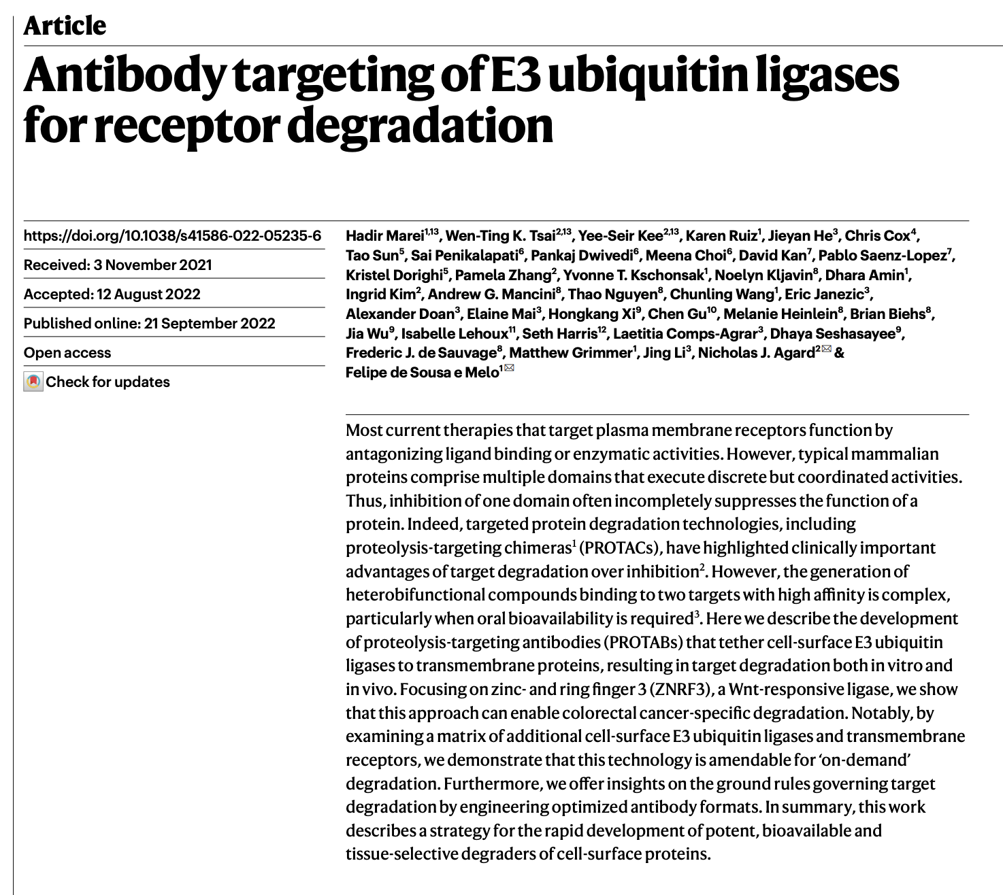
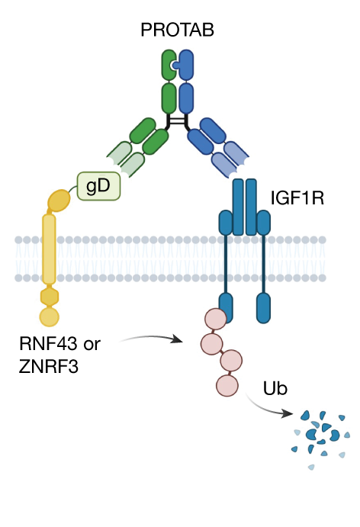

Slide 50
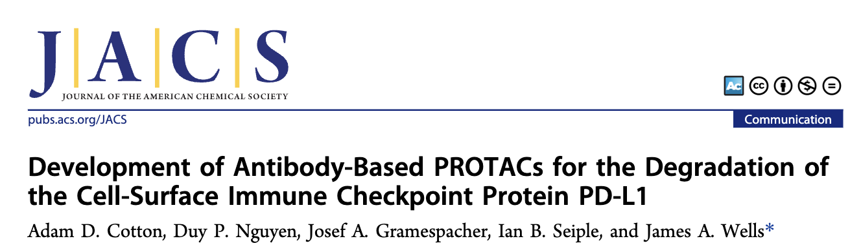
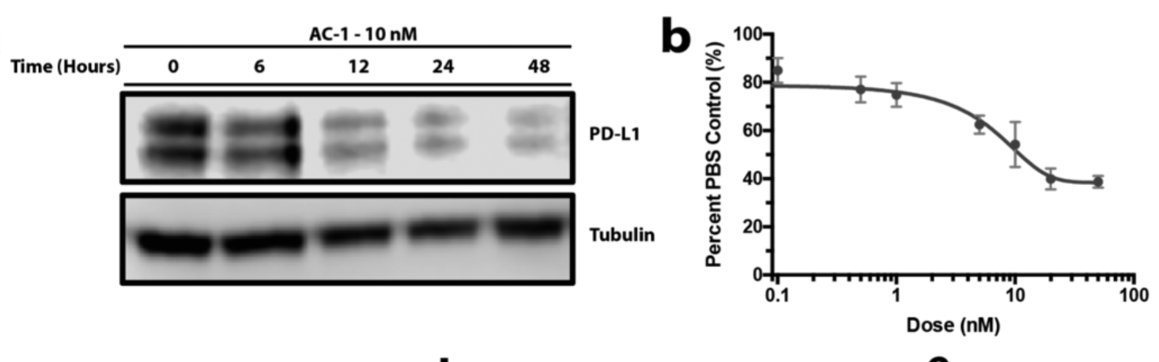


Slide 51
PROTABs
+ PROTABs are not only highly specific but also effectively bypass the challenge of intracellular compound delivery and offer a method to degrade cell membrane proteins that are considered undruggable.
- New modality! Not much experience - there sometimes proteins are just internalized (and degraded) when you add an antibody

Slide 52


Small molecule-nanobody conjugate induced proximity (SNACIPs)

Slide 53


Slide 54
SNACIPs
PROS: SNACIPs (small molecule-nanobody conjugate inducers of proximity) represent a first approach to redirect specific endogenous proteins to a desired intracellular location such as the plasma membrane, mitochondria, or the nucleus. This technology was for example used to redirect TPX2, an unligandable microtubule nucleation factor, to the plasma membrane, thereby inhibiting cancer cell proliferation.
CONS: delivery of the nanobody will be THE issue; may also be immunogenic

